Slide 1
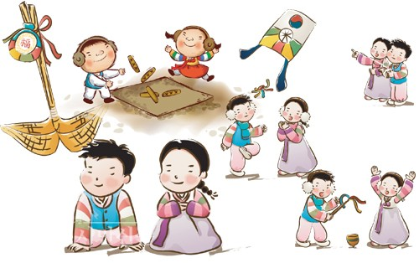

설날
Notes:
설날

Slide 2
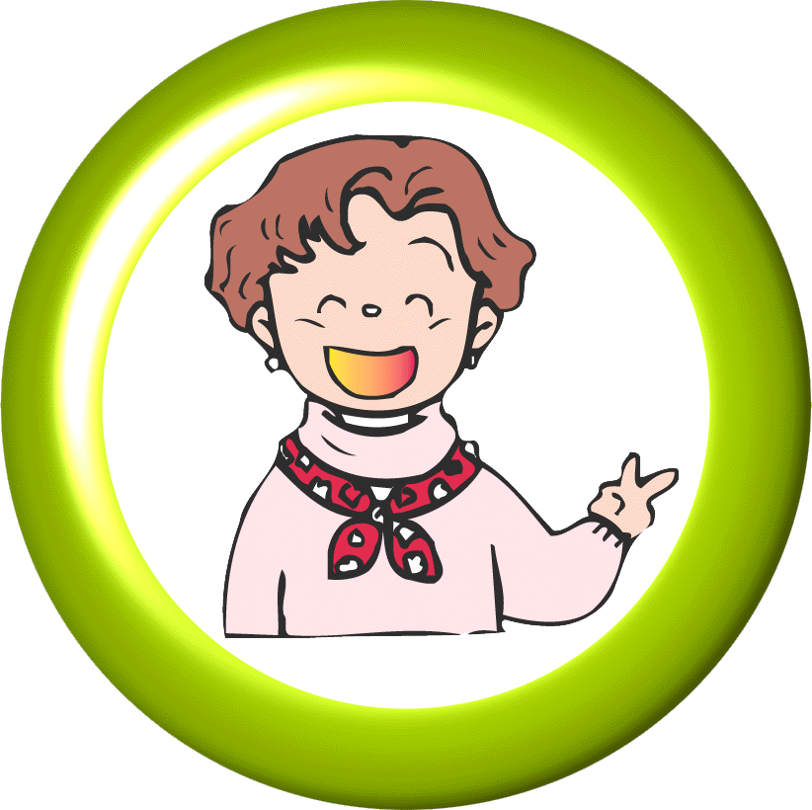
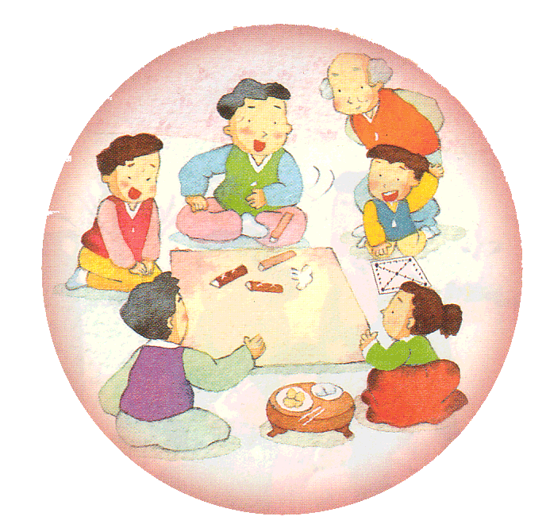
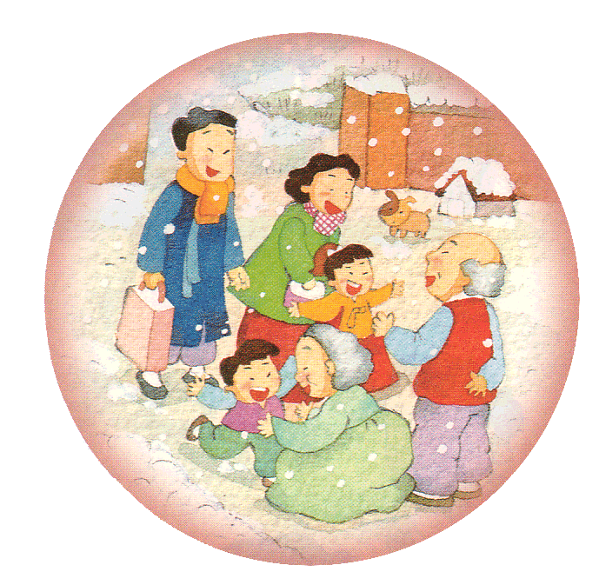
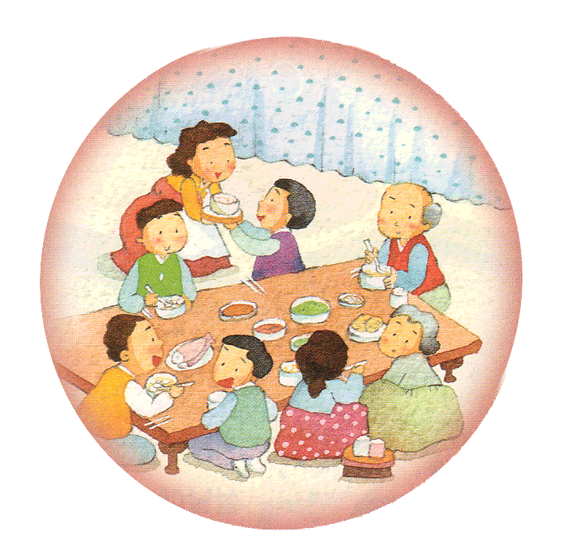
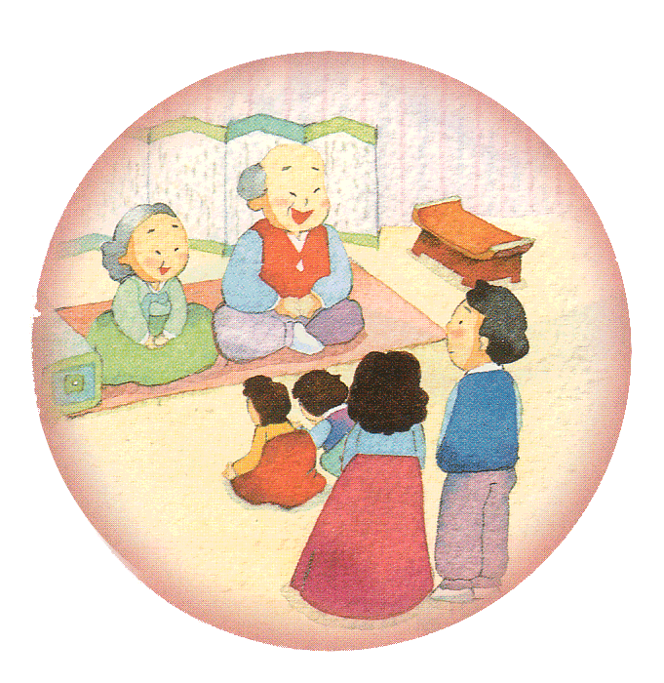
설날에 있었던 일을 이야기해 봅시다.
그림을 보며
설날에 있었던
이야기를
친구들과 재미있게 나누어 보세요.
Notes:
<click> What are you all doing on 설날?
<click> (그림 나온 후 설명 자동재생) What is everybody doing in the picture? … The family is playing 윷놀이.
<click> (그림 나온 후 설명 자동재생) What is happening in this picture? … The family is visiting their grandparents.
<click> (그림 나온 후 설명 자동재생) What are they doing in this picture? … The family is having a delicious meal together!
<click> (그림 나온 후 설명 자동재생) What about this picture? …The children are bowing and the grandparents are receiving 세배. Similar to all these pictures, people get dressed in 한복, play 윷놀이, eat together, and do 세배, with family and friends! Have you ever tried these activities on 설날?

Slide 3
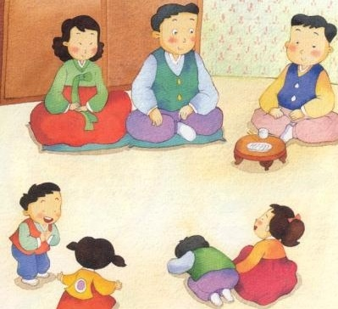
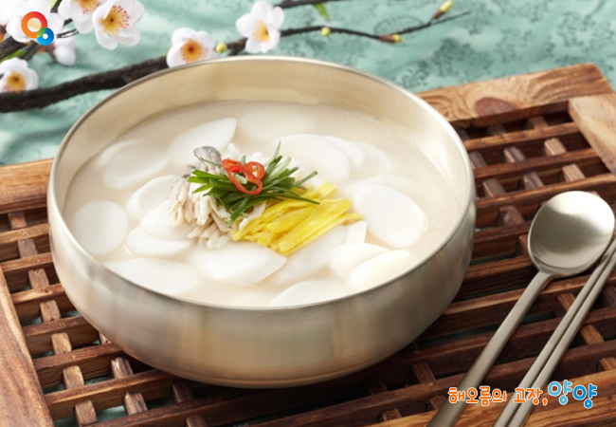
세배
떡국
Notes:
<click> (그림 나온 후 설명 자동재생) On 설날 children bow and adults receive 세배 and wish a Happy New Year. Kids say, “새해 복 많이 받으세요” and adults respond with, “새해 복 많이 받아라”. This is called 덕담. After 세배 the adults gift the children 세뱃돈, money for the bow. Have you tried 세배 before?
<click> (그림 나온 후 설명 자동재생) Also, We eat 떡국 on 설날.

Slide 4
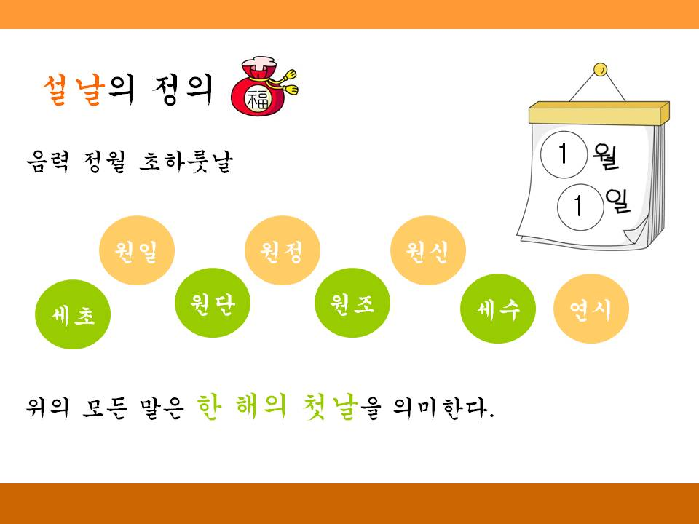
설날이란?
음력 정월 초하루(1월1일)
우리나라 최대의 명절
Notes:
설날 is the first day of the first month in the lunar calendar. It is the biggest holiday in Korean culture.

Slide 5
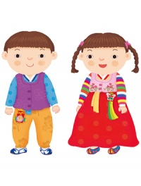
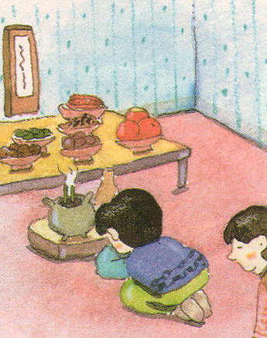
설날에는
설빔을 입어요
차례를 지내요
Notes:
<click> (그림 나온 후 설명 자동재생) On 설날 people wear a beautiful set of hanbok called 설빔.
<click> (그림 나온 후 설명 자동재생) Early in the morning on 설날, people pay respect to their ancestors. This act is called 차례.

Slide 6
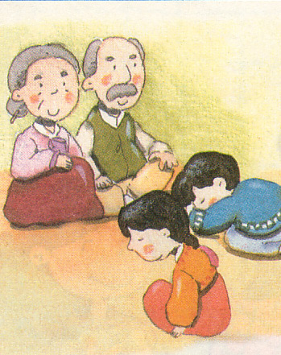
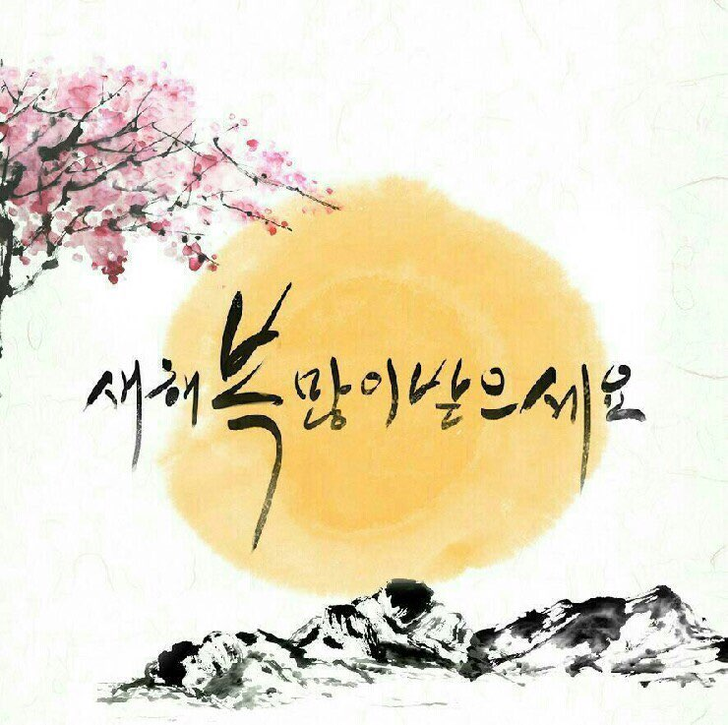
설날에는
세배를 해요
덕담을 나누어요
Notes:
<click> (그림 나온 후 설명 자동재생) Children bow and adults receive 세배.
<click> (그림 나온 후 설명 자동재생) The kids say “새해 복 많이 받으세요” and the adults respond with “새해 복 많이 받아라”. When adults receive 세배, they give gifts in return. Back then, kids would receive fruit, rice cakes, or 세뱃돈 after 세배, but nowadays they generally receive 세뱃돈.

Slide 7
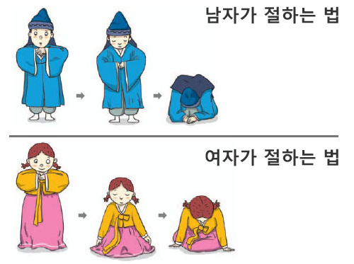
세배하는 법
Notes:
This is the correct way to do 세배. The boys stand on the right side of the girl and should put their left hand on top of their right hand and bring them up to chest level. As you sit, bring your hands down to the ground. Your left knee should hit the ground first. Check that your right foot sits on top of your left foot and that your elbows reach the ground. Finally place your forehead on the backs of your hands. After a moment, get up pulling your right knee up first. After you stand up, do a half bow. Girls place their right hand above their left hand and bring both hands up to shoulder level. Place your forehead onto the backs of your hands. Fold your left leg and then your right. While sitting, cross your feet behind you so that the left foot sits above your right foot. Lean 45 degrees forward. Take a moment then get up pulling your right leg up first.

Slide 8
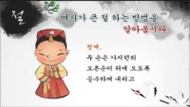
세배하는 법
https://youtu.be/shxOJtFMeLQ
Notes:
Let’s watch a video on 세배!

Slide 9
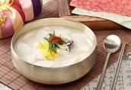
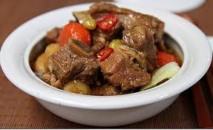
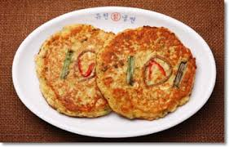
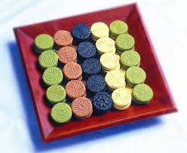
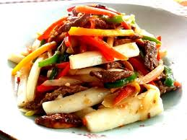
설 음식
떡국 갈비찜 녹두 빈대떡
다식
떡잡채
Notes:
On 설날, 떡국, 갈비찜, 녹두 빈대떡, 다식, 떡잡채, and more foods are offered to ancestors then eaten by the family for breakfast. Other foods that are enjoyed by the family are also eaten. Other delicious dishes can still be eaten without offering them to ancestors, 차례.

Slide 10
설날 민속 놀이
윷놀이
널뛰기
연날리기
Notes:
<click> What Kind of games are played on 설날?
<click> 그림 <click> (윷놀이 글씨 나온 후 설명 자동재생) This is 윷놀이 a game played with four wooden sticks.
<click> 그림 <click> (널뛰기 글씨 나온 후 설명 자동재생) This is 널뛰기, a long seesaw-like board jumped on by two people
<click> 그림 <click> (연날리기 글씨 나온 후 설명 자동재생) This is 연날리기, kite flying..

Slide 11
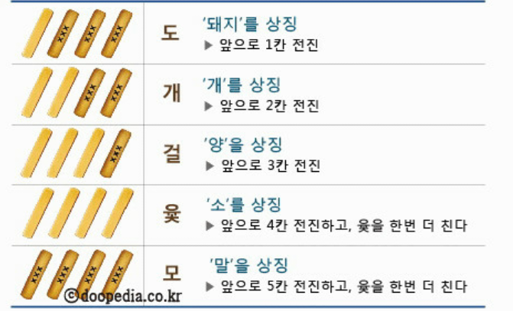
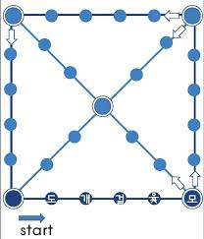
윷놀이
Notes:
Have you ever played 윷놀이 before? The 윷 is made of wood, and one side is round while the other is flat. 윷 is played by throwing the four wooden sticks. When all the sticks land and only one stick has its flat side faced up, it is called 도 and the team that threw the sticks can move a token one unit forward. If the sticks land with two flat sides up, it is called 개 the token can be moved two units forward. If the sticks land with three flat sides faced upwards, it is called 걸 and the token can be moved up three units. If all the sticks land with the flat sides faced upwards, it is called 윷 and the token can be moved forward four units. As a bonus, the one who threw the sticks gets another throw. If all the sticks land with the flat sides faced down, it is called 모 and the token can be moved forward five units, similar to 윷, 모 also earns a bonus throw. The first team to get all their tokens around the board wins. 도 means pig. 개 means dog. 걸 means sheep. 윷 means cow. 모 means horse. All these animals played an important role in farming.

