Slide 1
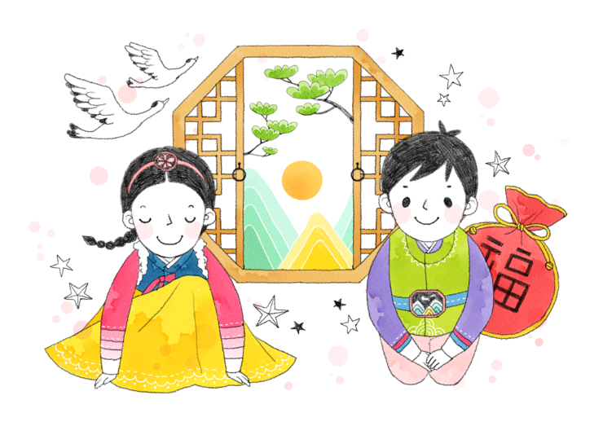

설
Notes:
설

Slide 2
설날
음력 정월 초하루 (1월 1일)
사린다, 사간다 (‘조심한다’는 뜻)
설빔
세배
차례
덕담
Notes:
설날 is the first day of the first month in the lunar calendar. It is the biggest holiday in Korean culture. People wear a beautiful set of traditional Korean Hanbok called 설빔 and give offerings to ancestors, which is called 차례. Also, adults receive 세배 and blessings are shared amongst everybody, this is called 덕담. 설 comes from the saying ‘사린다, 사간다’ which means to be cautious. 설 is not just a holiday to celebrate happiness but rather to recognize the cautious start to a New year.

Slide 3
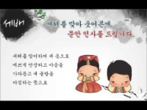
설날
https://youtu.be/eBGGAsA-BEM
Notes:
Let’s watch a video about 설날!

Slide 4
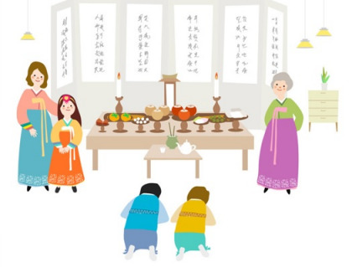
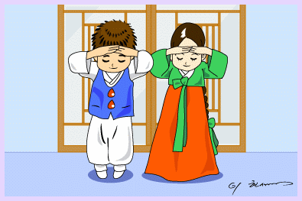
설날에 하는 일
차례
세배
Notes:
On 설날, people give offerings or have memorial ceremonies for ancestors. It is called 차례. Adults also receive 세배 from children.

Slide 5
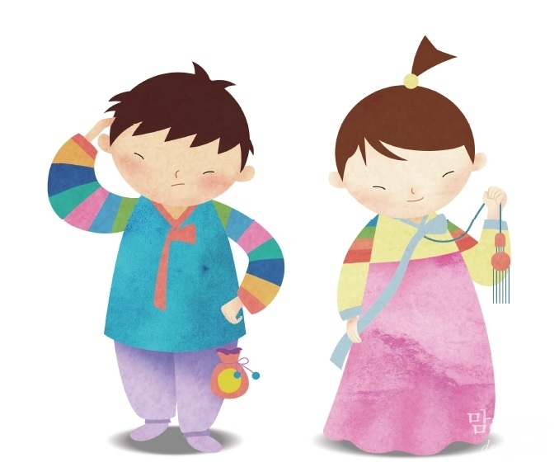
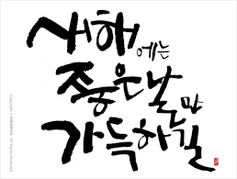
설날에 하는 일
설빔
덕담듣기
Notes:
These are special Hanboks called 설빔 worn on 설날. These Hanbok are made or bought new for the New year. Now wish one another a Happy new year. Blessings are shared amongst everybody, ‘새해 복 많이 받으세요.’

Slide 6
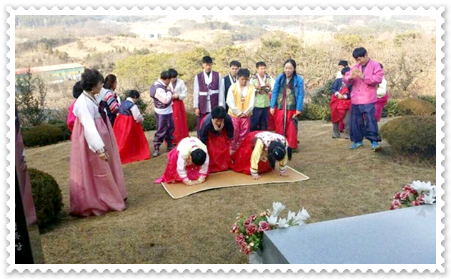
설날에 하는 일
성묘
복조리 걸기
Notes:
After 차례, people go to their ancestors＇ graves to greet them and to tidy up the grave site/s. This act is called 성묘. Also, on 설날, an item called 복조리 is hung in kitchens, rooms, or on walls. Long ago, 복조리 was used to wash rice. Now it represents weeding out bad things to leave the good, similar to its old use, of weeding out the bad thing to only leave the good rice.

Slide 7
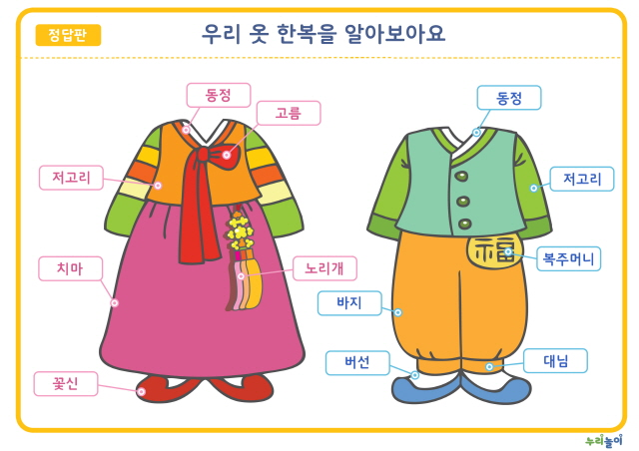
한복
Notes:
Now we will learn about the names of each part of the 한복. The piece worn on top is the 저고리. The white collar near the neck is the 동정 and the ribbon-like string is 고름. Girls wear skirts called 치마. They also wear socks, which is 버선 and shoes decorated with flowers, 꽃신. For even more decoration the 노리개 is added at the hip. The boys wear pants, 바지 that gathers together at the bottom with 대님, and also wear 버선 and shoes. Finally, they add a little pouch with the character for luck written on it called 복주머니 at their hip.

Slide 8
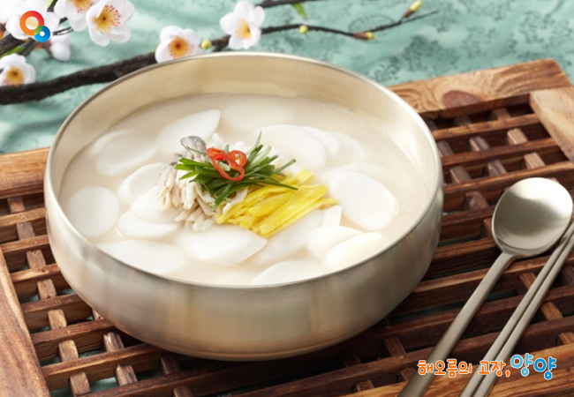
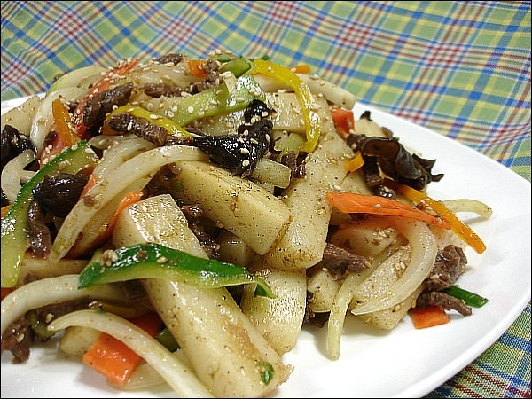
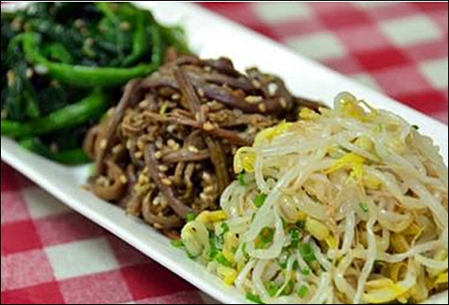
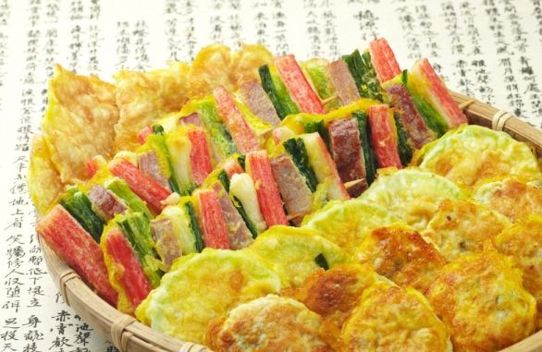
설날에 먹는 음식
떡국
떡잡채
삼색나물
전
Notes:
What types of foods do you eat on 설날? 떡국, 떡잡채, 삼색나물, 전, and many more foods are all offered to ancestors in the morning. Foods that are offered to ancestors, and foods that the family enjoys as well are eaten on 설날.

Slide 9
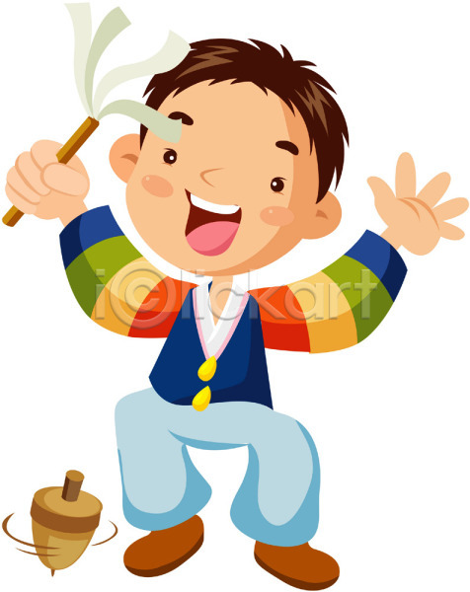
설날에 하는 놀이
윷놀이
팽이치기
Notes:
What kind of games are played on 설날? Games such as 윷 played with four wooden sticks, and 팽이 played with a top are some fun activities on 설날.

Slide 10
설날에 하는 놀이
널뛰기
연날리기
Notes:
The long seesaw-like board is a game called 널뛰기. Kids also make wishes as they fly kites on 설날. Sometimes the kite’s line is purposefully cut but it is considered bad luck and should be flown to blow the bad luck away. Occasionally kites will cut off other kite’s paths ensuing a kite fight.

Slide 11
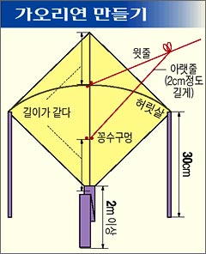
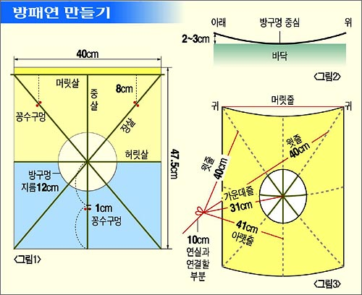
연만들기
Notes:
Now we will try making our own 가오리연, which is a stingray shaped kite and 방패연, which is a shield shaped kite.

